Slide 1

FINANCIAL HEALTH ANALYSIS OF PT Astra Agro Lestari Tbk (AALI)
A Comprehensive Balance Sheet Review (2020–2023)
Author: Riya Jain
by Riya Jain

Slide 2

Introduction: PT Astra Agro Lestari Tbk (AALI)
PT Astra Agro Lestari Tbk is one of Indonesia’s largest palm oil producers.
AALI focuses on sustainable plantation operations, as well as CPO and derivative product sales.
It is publicly listed on the Indonesian Stock Exchange (IDX: AALI).
The company operates across Sumatra, Kalimantan, and Sulawesi.

Slide 3
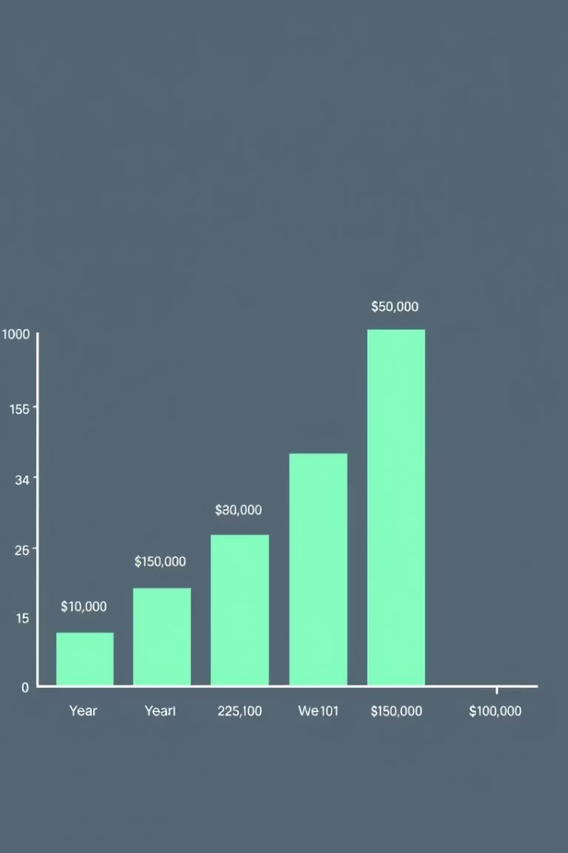
Overall Financial Performance: Balance Sheet Overview
Total Assets
7.39T
9.67T
Total Liabilities
0.77T
0.84T
Total Equity
4.84T
4.84T
AALI demonstrated consistent balance sheet strength from 2020 to 2023. Total Assets grew while Total Liabilities decreased. Total Equity steadily increased.

Slide 4
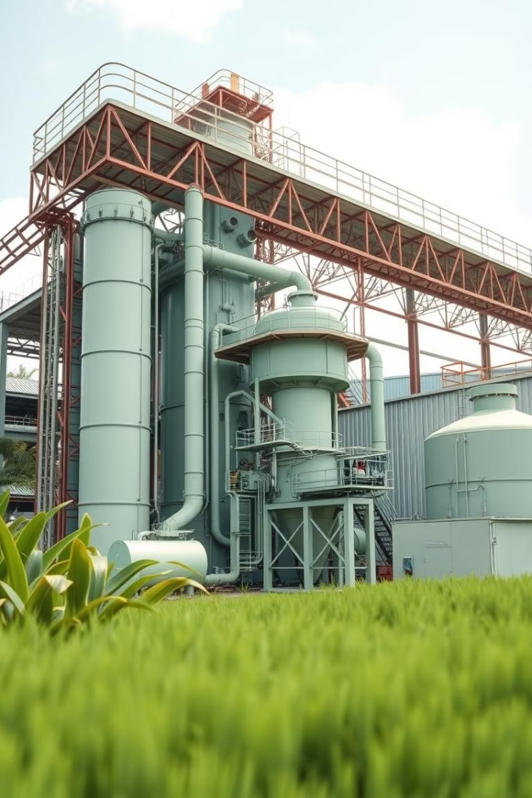
Asset Analysis: Stability and Strategic Investment
Strategic Capital Investment
ALI’s long-term assets include Buildings and Improvements, offset by Accumulated Depreciation, highlighting continued investment in infrastructure and operational assets.
Strengthening Cash Position
Cash and Equivalents rose from approximately IDR 872B in 2020 to
IDR 1.87T in 2023, indicating stronger liquidity and improved short-term
flexibility.
Sound Asset Structure
The presence of cash, receivables, and physical infrastructure suggests
a balanced asset base — supporting both day-to-day operations and long-
term capacity.
.

Slide 5








Liability Analysis: Prudent Financial Management
Significant Liability Reduction
Decreased Short-Term Loans
Short-term bank loans were reduced to IDR 260B in 2023, supporting short-term financial stability.
Total liabilities showed a downward trend.
Strong Liquidity
Manageable Long-Term Debt
This indicates a healthy liquidity position and minimal reliance on short-term funding.
Long-term debt stood at IDR 1.69T (2023), reflecting conservative debt management and long-term leverage

Slide 6
Equity Analysis: Robust Shareholder Foundation
1
Equity Remained Stable
Total equity unchanged by au IDR 4.84T since 2020.
High Equity-to-Asset Ratio
2
Reached 22.0% in 2023, signaling a moderate financial stability.
Retained Earnings
3
The majority of equity, reflecting consistent profitability and reinvestment strategy.
Strong Financial Base
4
Supports future expansion and enhances resilience.

Slide 7




Key Financial Ratios: Indicator of Health
Debt-to-Equity Ratio
0.17x in 2023 (slightly up from 0.16x in), indicating very healthy Conservative leverage.
Current Ratio
3.03x in 2023 (vs. 1.0x in 2020), ensuring sufficient short-term liquidity.
Equity Ratio
0.22 in 2023, confirming moderate leverage and a strong ownership stake.
AALI's strong balance sheet structure provides a solid foundation for sustainable operations and strategic growth initiatives.

Slide 8





Conclusion & Outlook: Solid Financial Position
Highly Stable Balance Sheet
AALI maintains a robust financial standing.
Prudent Debt Management
Key strength and robust equity growth.
Resilience to Market Fluctuations
Strong liquidity supports market stability.
Focus on Sustainability
Continued operational efficiency and sustainable practices are expected.

